Slide 1
Social Media: what can the Bocce Ballers do?
PR: Cases & Problems- Special Olympics: Bocce Bash

Slide 2
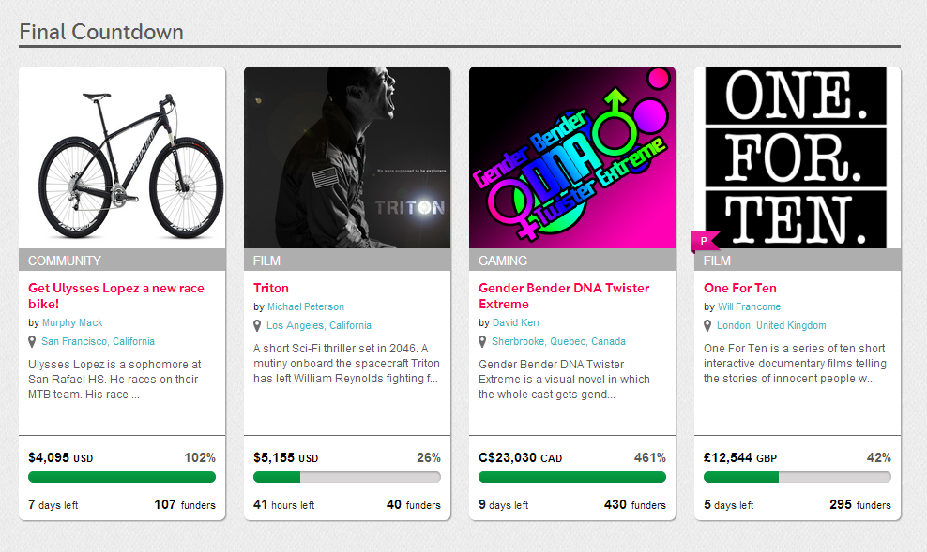
Indiegogo
Site used to:
Raise money (crowd funding)
Gain global exposure
Get inspired

Slide 3
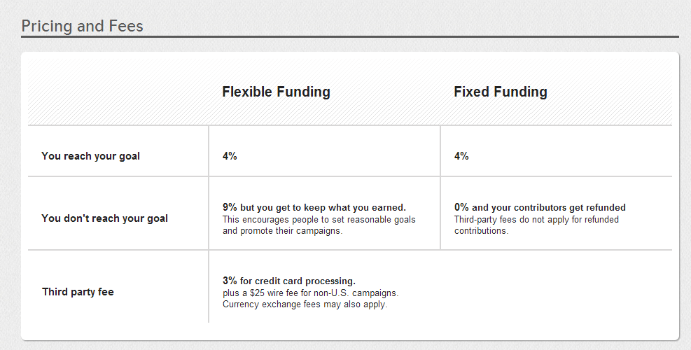
Indiegogo: Pricing & Fees

Slide 4
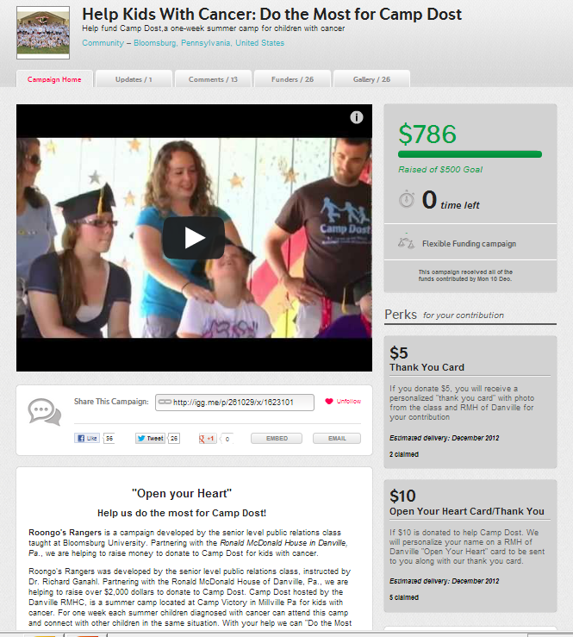
Indiegogo: What do WE need?
Title
Logo
Slogan
Campaign description
Promotional Video
“Perks” of donating

Slide 5
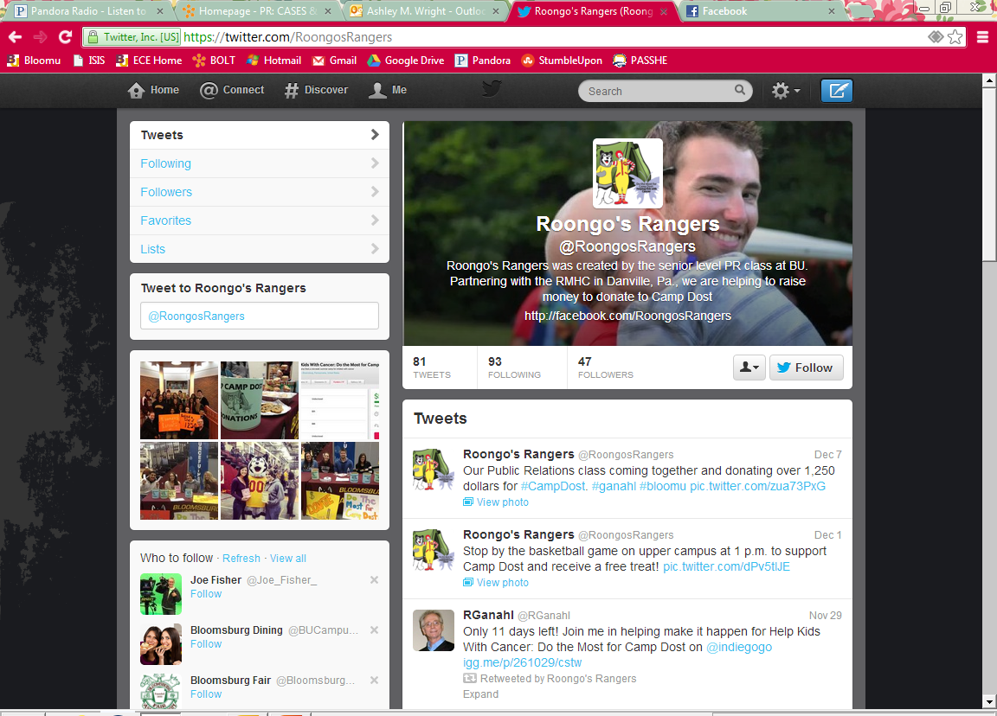
Twitter: What do WE need?
Logo
Slogan
Tweet every day!
Followers

Slide 6
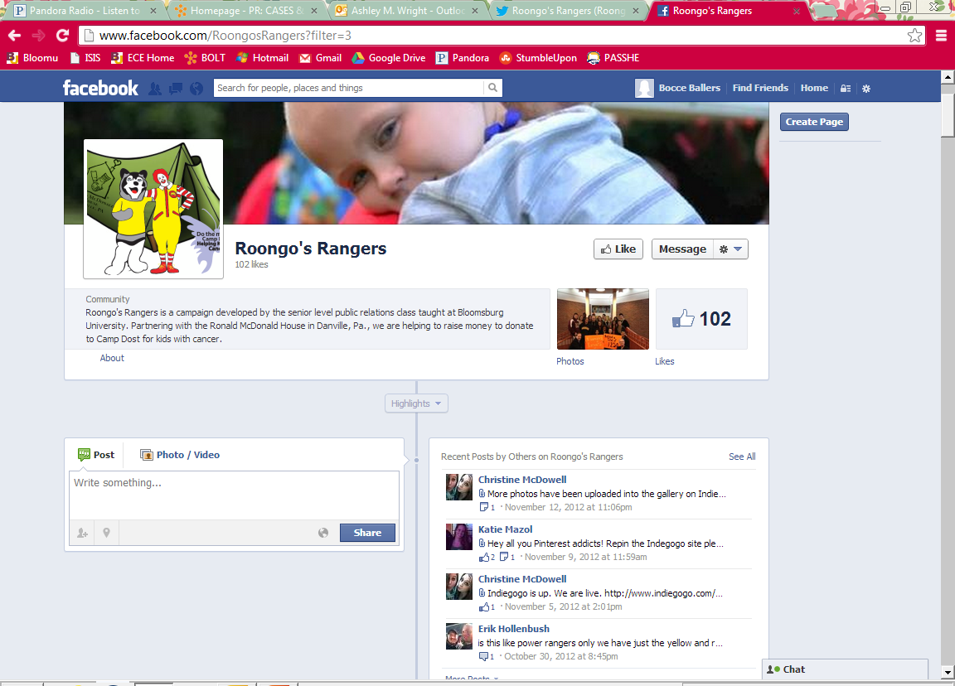
Facebook: What do WE need?
Logo (Profile Picture)
Description
Events page

Slide 7
Questions
Indiegogo:
Fundraising goals?
Do we want an account separate from Roongo’s Rangers?
Create an Instagram?
Any questions?

